Slide 1
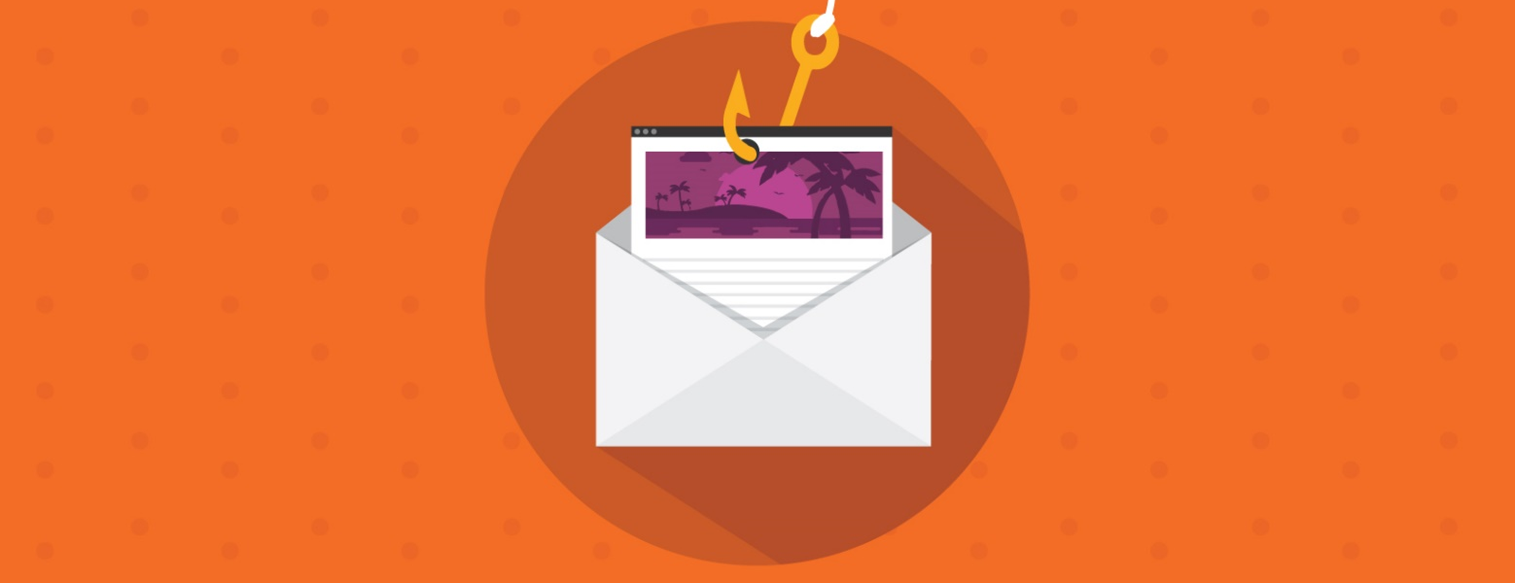
Phishing email attacks
ARTUR NAGAEV ID 70230

Slide 2
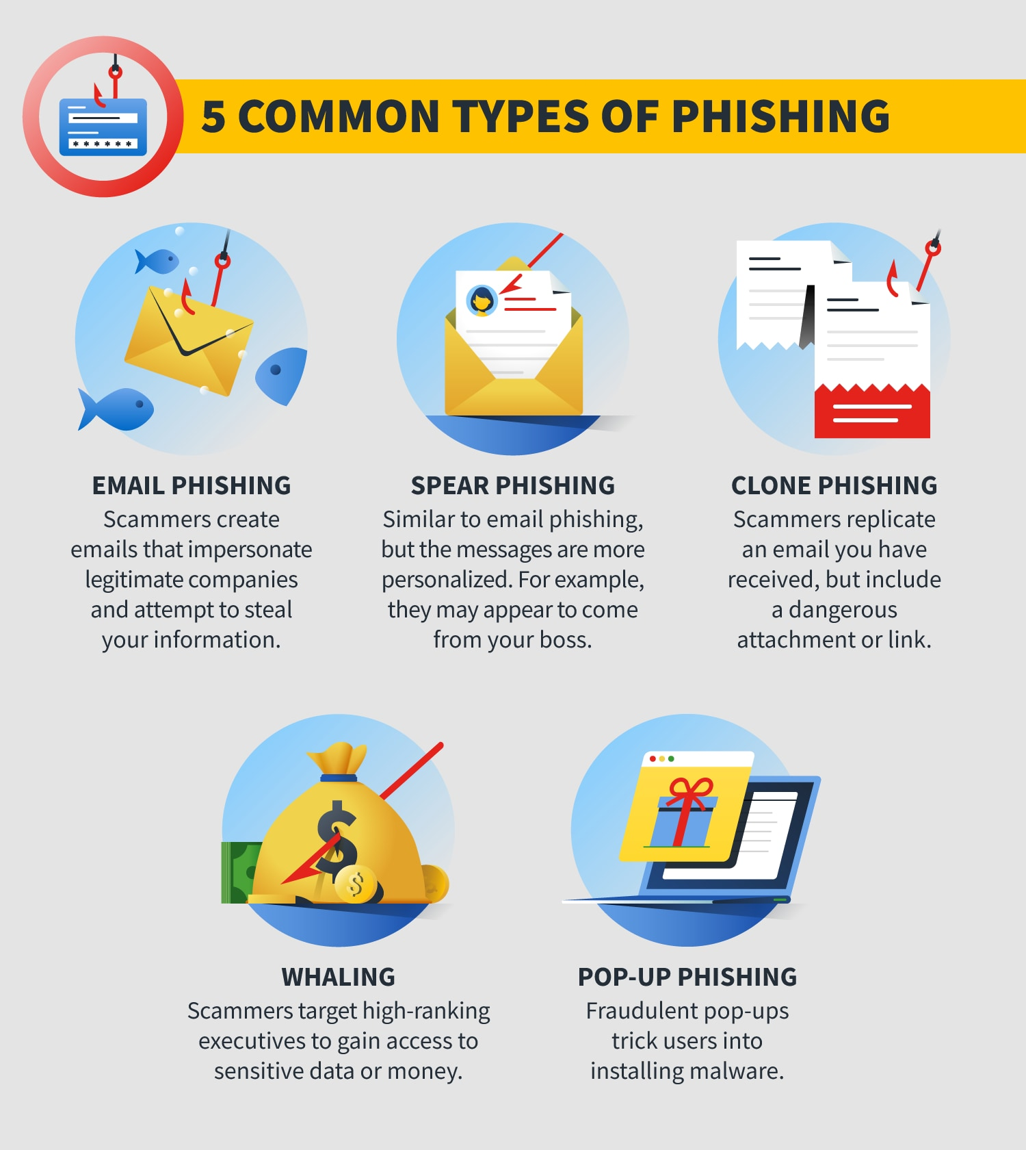
5 Common types of phishing
Email phishing
Spear phishing
Clone phishing
Whaling
Pop-up phishing

Slide 3
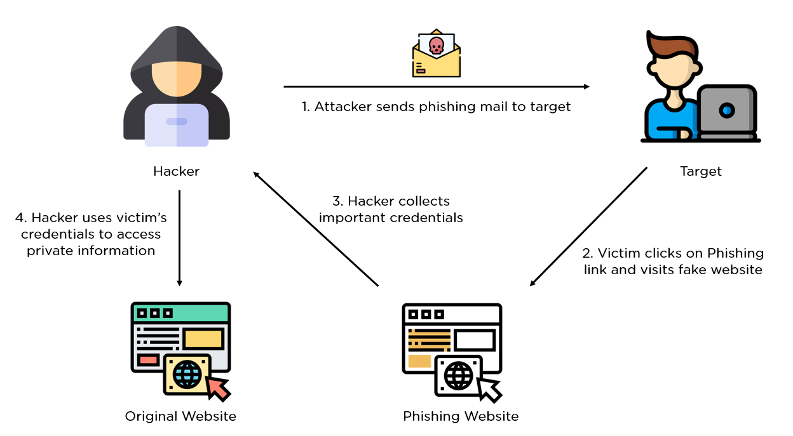
What is a Phishing Attack And How does it work?

Slide 4
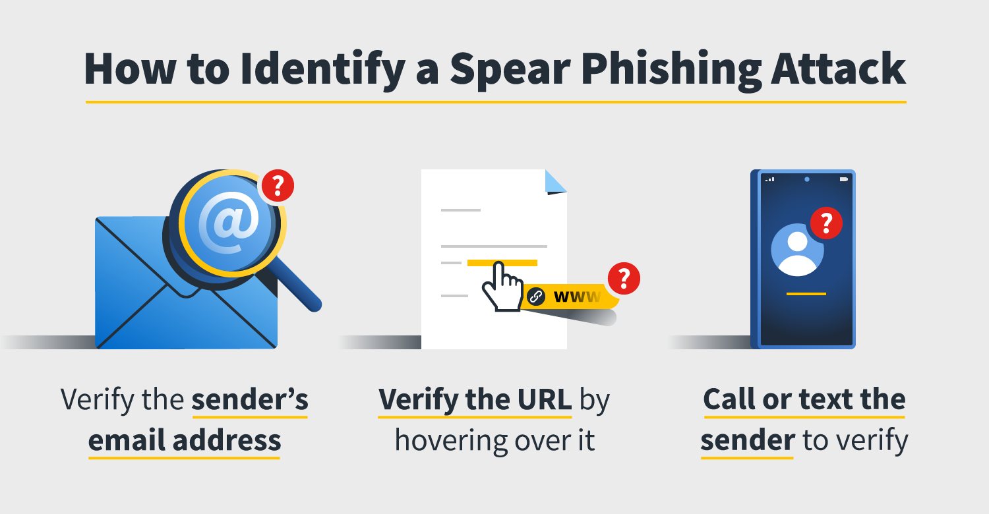
How to Identify a Spear Phishing attack

Slide 5
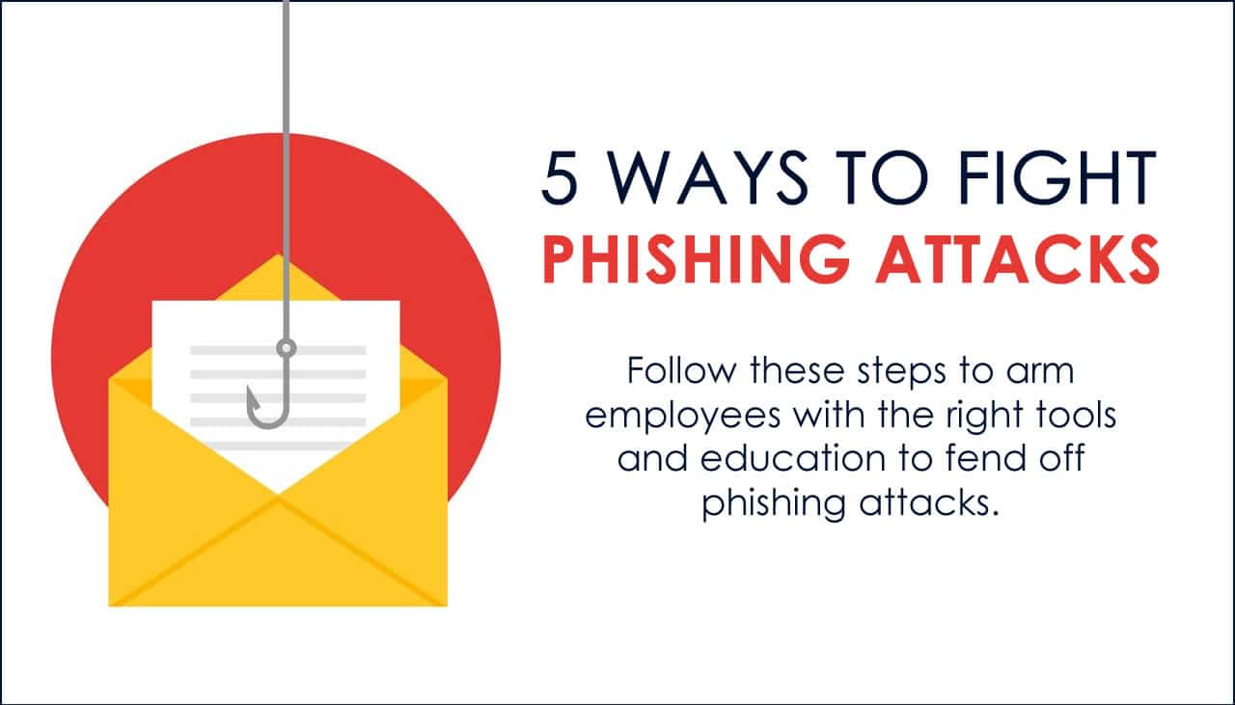
How to Prevent Phishing

Slide 6
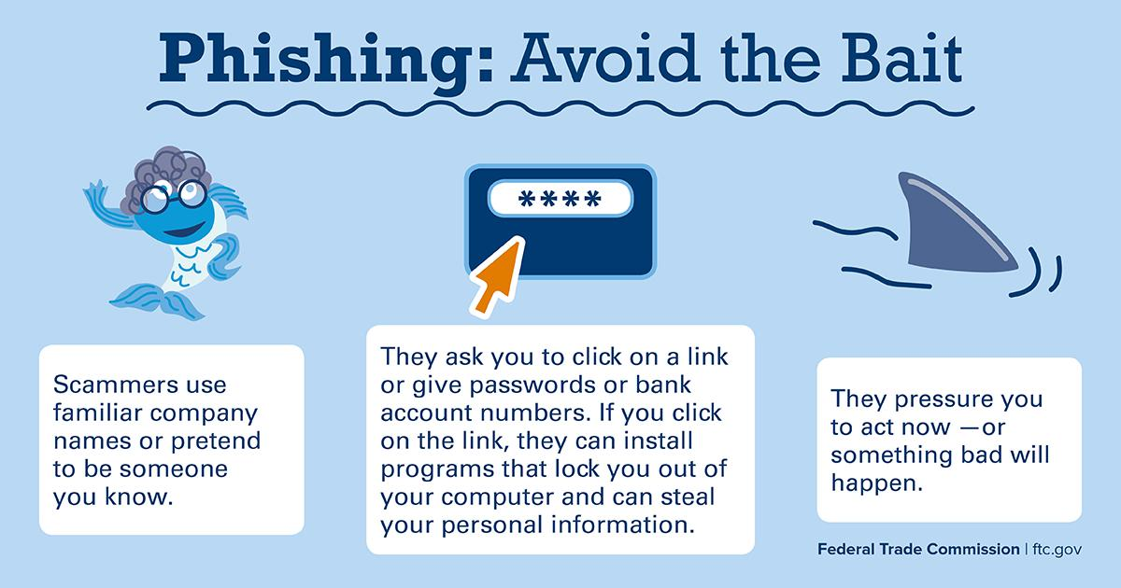
Investigate every link’s final destination
We’re all email marketers here. Links, UTMs and redirects are sprinkled throughout every email we send. Same with emails that we receive. Just because a link is typed out and looks like a normal hyperlink doesn’t mean the destination is authentic.
To find out if a link is real, hover over it with your mouse and look at the link’s destination in the lower left corner of your browser. This is the real destination, regardless of what the text says.
Alternatively, you can type the URL manually into a new search bar.

Slide 7
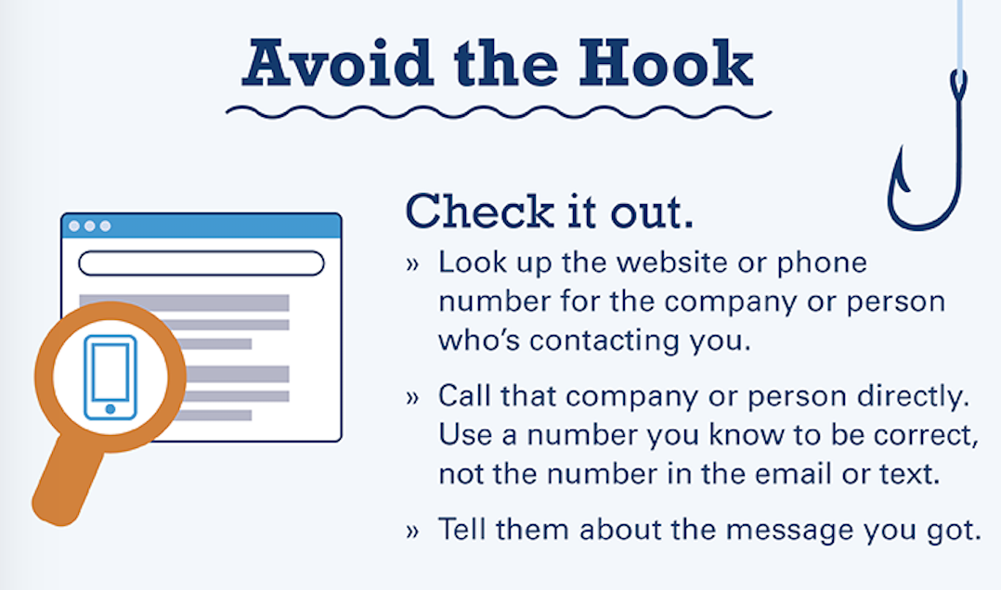
Take “urgent” deadlines with a grain of salt
No legitimate company will ever ask for your personal data via email. If you see a message that’s trying to get you to take “urgent” action (aka, sending your personal info), call the company directly and ask. When it comes to your data, you’d rather be safe than sorry.
Always make account updates yourself or call the company using the number you find on their website (not the number the email provides—that could be fake too).
Scammers will impose bogus deadlines and will sometimes even use threatening tones in their messages. When you know it’s a phisher, mark that b.s. as spam and send it to the trash where it belongs.

Slide 8
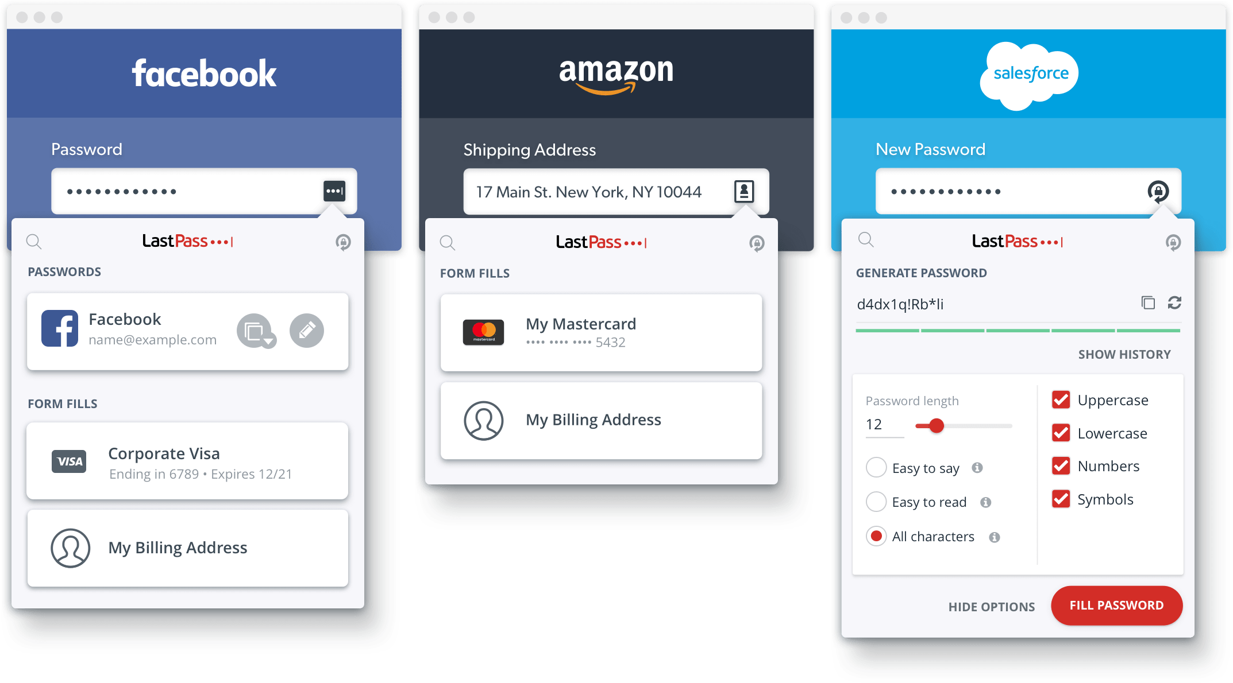
Change your passwords frequently
We know, we know. This can be a pain in the butt. “Don’t use the same password more than once,” they say. “Change them often,” they harp. Unless you work in IT or Security, you most likely use the same password, like your street name and kid’s birthday. The truth is, having a unique password for each account has never been easier.
There are reputable platforms available you can use to create strong passwords and store them for safekeeping, such as LastPass. Platforms like this one are seamless and reliable for keeping data secure.

Slide 9
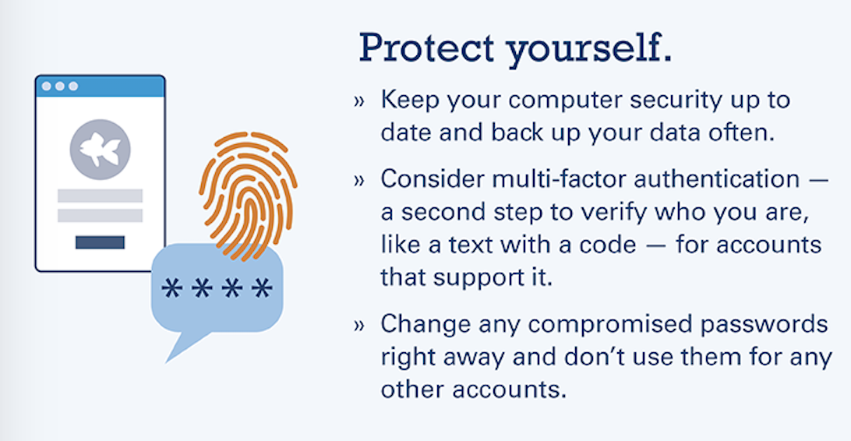
Set up two-factor authentication
Many organizations offer two-factor authentication for an extra layer of security. Take advantage of this whenever possible so no one else can log in without needing your device.

Slide 10
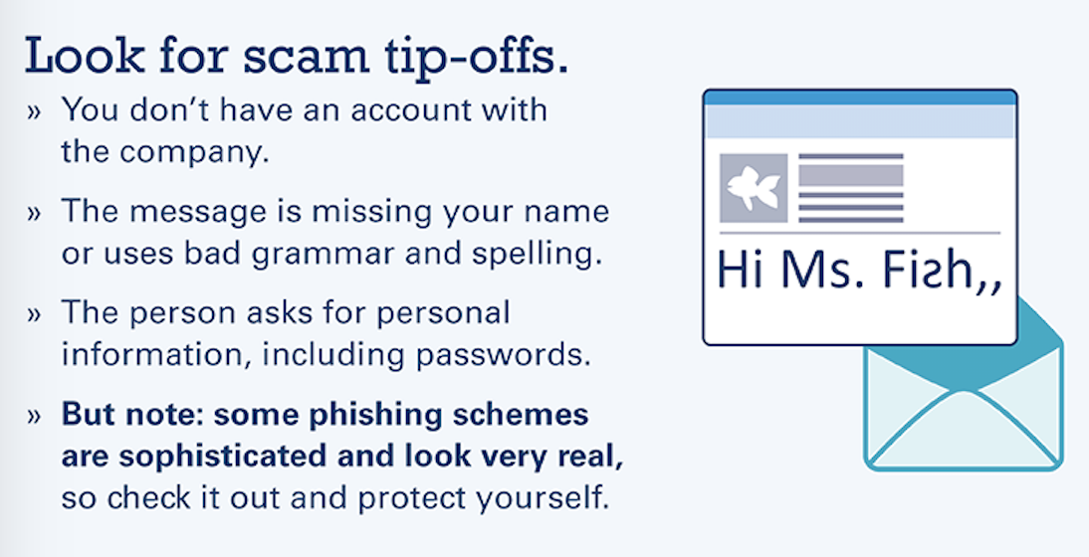
Trust your gut instincts
If an email looks or feels off to you (even if you have very little reason to think so), trust your instincts. You’ve likely seen a garbage phishing email at some point, littered with typos and grammatical errors, unprofessional imagery, and just not a clean, crisp experience like you’d normally expect.
When an email or other interaction feels off to you, save yourself a potential headache and trust your gut.

